Slide 1
Study design
Region (Block) | Survey | Environmental
 | Adaptation measure, wealth etc | Drainage area, rainfall etc
Ariquemes
Ouro Preto do Oeste
Rolim de Moura

Slide 2
Statistical approach(I)
Data import and cleaning
Removing duplicate records
Removing missing values
Create new variables (drainage area, region)
Exploratory Data Analysis (EDA)
Graphs
Histogram - Distribution
Bar graph - Compare counts of categorical variables (adaptation measures)
Box plot – visualize the difference in numeric variables (drainage area, rainfall) of categorical variables (adaptation measures)
Dot plots – visualize relationship between two variables
Tables
Contingency (counts of three regions)
summary of numeric variables (drainage area, rainfall, SPI. Vechval etc)

Slide 3
Statistical approach (II)
Two sample t-test
Compare drainage area of individual adaptation measures
Compare rainfall of individual adaptation measures
Compare vechval of individual adaptation measures
ANOVA analysis
Three regions as the factor
Effect of region on drainage area
Effect of region on rainfall
Effect of region on wealth
Logistic Regression
individual adaptation measures ~ log (drainage area)
individual adaptation measures ~ vechval
individual adaptation measures ~ rainfall
Any_adaptation measure ~ log (drainage area)
Prediction

Slide 4
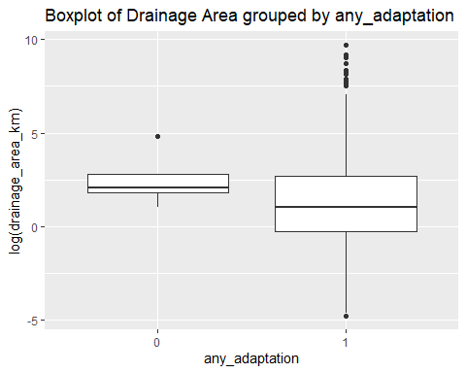
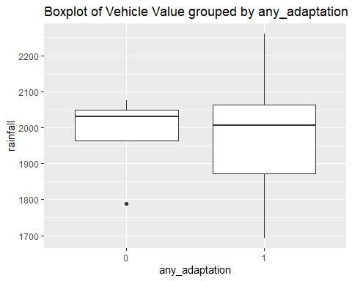
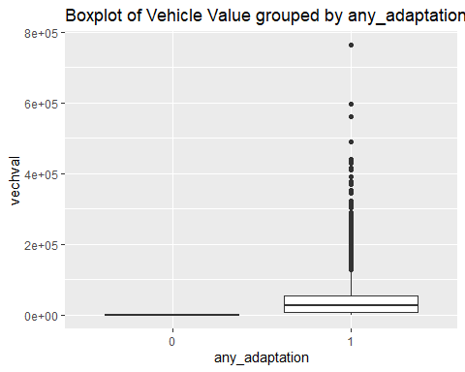
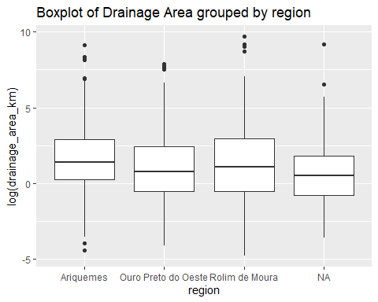
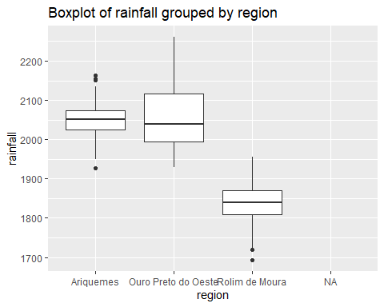
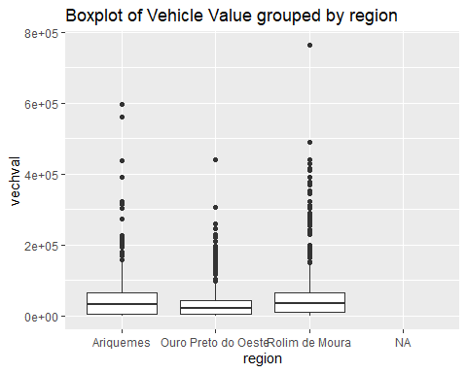
Result
EDA and T-test shows adopt of adaptation measures have different log drainage area, rainfall
p-value = 2.756e-10
p-value = 0.04973
EDA and ANOVA analysis shows different log drainage area , rainfall and vechvalue on regions
p-value = 0.00342
p-value <2e-16
p-value =6.41e-07

